Slide 1


MIS & SD Department - 2024 Goals’ Status

Slide 2
Overview
Another year has passed, and with it, the MIS & System Development (MIS & SD) Department has continued its journey of innovation and progress.
In 2024, we set ambitious goals to streamline operations, enhance system efficiency, and empower our organization with robust technological solutions.
Today’s presentation will provide an overview of:
Key milestones achieved
Challenges faced
Steps ahead to fulfill our objectives.
This reflects our ongoing commitment to driving excellence and supporting the company’s vision for growth and digital transformation.

Slide 3

Goals’ Status
Goal | Previous Status | Achievement | Status
Approval Management: Mobile Responsive | Web Based | Implemented successfully | Complete
Auto Leave Apply | Manual paper-based | Implemented in HO, Corporate, Unit IT, and Commercial | Implementing
Conveyance Bill | Manual paper-based | Implemented in HO partially | Implementing
Graphical Dashboard | Only the table dashboard is available | Implemented for HR, SCM, Garments, and Sustainability | On-going Process
Transport Automation | Partially Usage has some difficulties on the user’s end | Implemented for Pull Car | Partially Done
Final Settlement | Manual paper-based | The system is running smoothly | Complete
Visitor Management | Manual | Zone A complete. Zone B & C are pending | Implementing

Slide 4
Goals’ Status
Goal | Previous Status | Achievement | Status
News Portal & Blog | No active news portal | Running | Complete
Dyeing Implementation | On going Implementation | CKL-Planning to store is completed, Masco Dyeing- Planning to QI is completed | Partially Done and On-going
Accessories Booking | Manual/Excel Based | The operation could not be initiated. | Not started.
Separation Process Automation | Manual | 70% development complete | On-going
Database Security & Application Performance | External Threat was minimized and performance was average | Optimization: Indexing, more memory, query rewriting, load balancing, and file separation Security: Audits, server separation, custom ports, and real-time monitoring | Continuous Process
School Management System | Student, Teacher & Parent database was ready | Development complete, implementation is on-going | Implementing
Ahle-Hadiths | The system was ready, yet to deploy & implementation | Fully Running | Complete

Slide 5
Approval Management: Mobile Responsive.
Goal:
Current Status:
Next Action Plan:
Enhancing the system for mobile browser compatibility.
Implemented for store requisition & purchase orders for SCM.
100% Mobile responsive leave application and approval system used in HO and Corporate.
Also implemented for Conveyance bill(HO Partially) and Gate pass.
Add additional approval systems if needed.

Slide 6
Auto Leave Apply
Goal:
Current Status:
Next Action Plan:
Fully implement the automated leave application system across the entire organization.
Implemented in Head Office (HO) and Corporate Unit.
Also implemented in all Units' IT departments and Commercial Departments.
Implement in all units.
Include the Short Leave Application feature in the system.

Slide 7
Conveyance Bill
Goal:
Current Status:
Next Action Plan:
Fully implement the automated conveyance bill system across the entire organization.
Partially implemented in Head Office (HO).
Implement in all units.

Slide 8
Graphical Dashboard
Goal:
Current Status:
Next Action Plan:
All production module data visualization & comparison.
Implemented for HRIS, SCM
Also implemented some dashboards for the Garments module and Sustainability.
Develop more dashboards for management levels.
A completely new dynamic module with dashboards for top management.

Slide 9
Transport Automation
Goal:
Current Status:
Next Action Plan:
Make it upgrade and more user-friendly and reliable.
Real-time vehicle location tracking of pull cars.
Vehicle monitoring reports of pull cars.
Implemented in some units.
Implement in all zones.
Include shipment/cargo vehicles in the system.
Implement Vehicle Requisition operation.

Slide 10
Final Settlement
Goal:
Current Status:
Next Action Plan:
Fully implement the automated final settlement system across the entire organization.
Complete.
If possible, the final settlement payment will be made through the bank.

Slide 11
Visitor Management
Goal:
Current Status:
Next Action Plan:
Fully implement the system across the entire organization.
Implementation in Zone A has been completed.
Implementation in Zones B and C is pending.
Implement in zone B and C.

Slide 12
News Portal & Blog
Goal:
Current Status:
Next Action Plan:
Integrate with the MASCO Groups’ website & with MASCO ERP.
Complete.
Publish on MASCO Groups’ website after filtering confidential data.

Slide 13
Separation Process Automation
Goal:
Current Status:
Next Action Plan:
Make it simple for individuals & other relevant departments.
70 % of the development is completed.
Complete the development.
Complete the implementation of the system in the next year.

Slide 14
Dyeing Implementation
Goal:
Current Status:
Next Action Plan:
Complete implementation in three dyeing units.
CKL Dyeing: Planning to Store operation is completed,
Masco Dyeing: Planning to QI operation is completed.
MEL Dyeing: Couldn’t start the implementation due to lack of instrument support.
Complete the implementation in all three units as early as possible.

Slide 15
Accessories Booking
Goal:
Current Status:
Next Action Plan:
Cover all the accessories booking of all the buyers of MASCO.
Not Started. Because we couldn’t facilitate merchandising module automation.
We have automated the Merchandising module and plan to complete the accessories booking for H&M buyer in the upcoming year.

Slide 16
School Management System
Goal:
Current Status:
Next Action Plan:
Online Payment.
Attendance Management.
Exam & Result Management.
Yearly Schedule/ Calendar Management.
Student, Teacher & Parents Profiling
Development is completed but not implemented.
Complete the implementation by next year.

Slide 17
Ahl al-Hadith
Goal:
Current Status:
Next Action Plan:
Implement it successfully
Implemented Successfully.
Integrate the Online Payment System.

Slide 18

Database & Application Performance
Goal:
Current Status:
Next Action Plan:
Internal security & performance enhance.
Increased system memory.
Optimized queries.
Implemented load balancing.
Optimization of customizations and integrations.
Improved indexing.
Identify frequently accessed columns.
Separate data and log files.
Archiving all databases.
Update database version.
Create database table vertical & horizontal partitioning to increase better performance.

Slide 19

Database & Application Security
Goal:
Current Status:
Next Action Plan:
Internal security & performance enhance.
Regularly review and audit security settings.
Separate database servers for application and database.
Avoid using default network & database ports .
Use real-time database monitoring.
Multi-master replication system integration.
Move some applications to the cloud platform.
Database performance optimization.

Slide 20
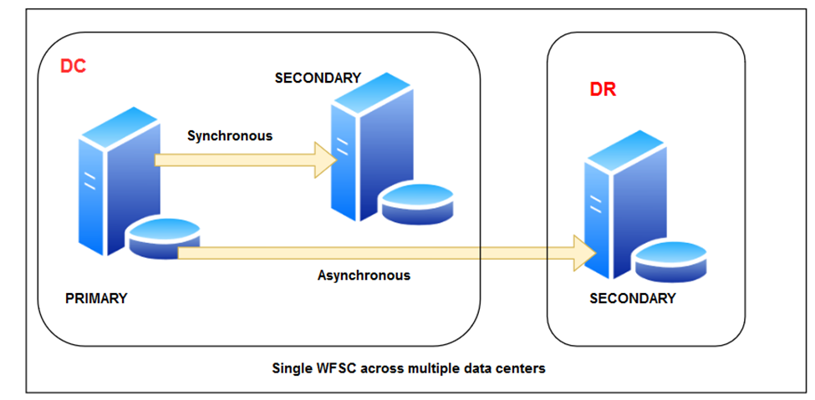
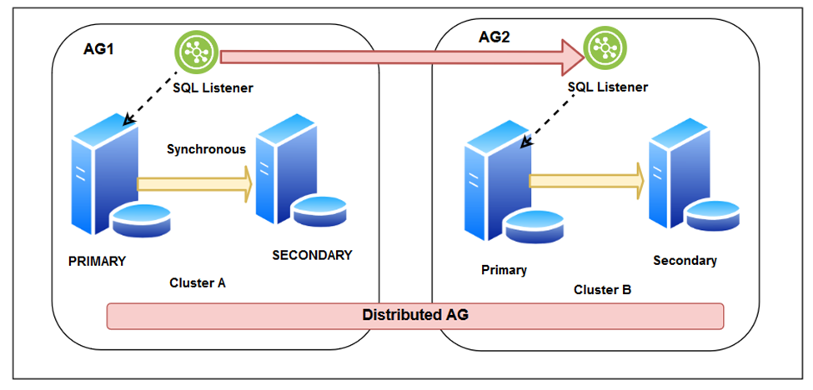
Multi-master replication system
Previous system
Planed for 2025

Slide 21
Achievements Beyond Set Goals
Sample Card Printing system for multiple buyers.
Embroidery Production Follow-up.
Incentive program of Garments.
Garment Earning Dashboard.
Buyer visit/ Event Schedule System and Calendar.
Garments printer Cutter Blade cost minimization.
Dyeing Automation in CKL Dyeing Sample section.
Cutting Roll Cost Optimization.
Automated OCR-Driven PO Upload and Job Creation System for Bonprix, IDKIDS, and ZARA Buyers.

Slide 22
Cutting Roll Cost Optimization.
Total Savings per year is
BDT 1,56,33,006/-
Bundle Roll
Previous:
Each role cost: 5265
Per year role needed: 6000
Current:
Each role cost: 3510
Per year role needed: 6000
Previous Cost (BDT) | Current Cost (BDT) | Total Save/year (BDT)
5265 * 6000 = 31,590,000 (Three crore fifteen lakh ninety thousand) | 3510 * 6000 = 21,060,000 (Two crore ten lakh sixty thousand) | 10,530,000 (One crore five lakh thirty thousand)
Ribbon
Previous:
Each role cost: 3315
Per year role needed: 4200
Current:
Each role cost: 2700
Per year role needed: 4200
Previous Cost | Current Cost | Total Save/year
3915 * 4200 = 16,443,000 (One crore sixty-four lakh forty-three thousand) | 2700 * 4200 = 11,340,000 (One crore thirteen lakh forty thousand) | 5,103,000 (Fifty-one lakh three thousand)

Slide 23
Garments printer Cutter Blade cost minimization
Total Savings per year is (88%)
BTD 7,573,507/-
Previous Cost:
Cost after 1st Development: (84%)
Cost after 2nd Development: (23%)
Per Printer Cutter price | 42,000 BDT
Total printer cutter needed in 7 units per month | 17 pcs
Total cost per month | 42,000*17 = 714,000
Total cost per year | 714,000*12 = 8,568,000 (Eighty-five lakh sixty-eight thousand BDT)
Per Printer Cutter price (one time) | 42,000 BDT
Total printer cutter needed in 7 units | 17 pcs
Total cost for printer cutter per year | 42,000*17 = 714,000
Per Cutter blade Price | 3,000
Total cost for cutter blade per year | 3,000*17*11 = 561,000
Total cost per year | 714,000+561,000 = 1,302,000
Savings after 1st development | 7,266,000 (Seventy-two lakh sixty-six thousand BDT)
Per Printer Cutter price (one time) | 42,000 BDT
Total printer cutter needed in 7 units | 17 pcs
Total cost for printer cutter per year | 42,000*17=714,000
Total cost for cutter blade per year | 3,000*17*5 = 255,000
Total cost for sharping | 250*17*6= 25,500
Total cost per year | 714,000+255,000+25,500 = 994,500
Additional Savings after 2nd development | 307,500 (Three lakh seven thousand five hundred BDT)

Slide 24
Auto Leave Apply: A Paper-Free Solution
Total Savings per year is
16800 BDT in all units.
HO and Corporate unit
2023 | 5,000 leave applications on paper (approx.)
Per piece paper price: 0.84 BDT
Approximately 5,000*0.84 = 4200 BDT are saved annually in HO and Corporate units.
All units combined
2023 | 20000 leave applications on paper (approx.)
Per piece paper price: 0.84 BDT
Approximately 20,000*0.84 = 16800 BDT will be saved annually across all units with the implementation of the auto leave application system.

Slide 25

Thank you !

